Slide 1
BHAVANA
DAY 18
27/04/2024

Slide 2
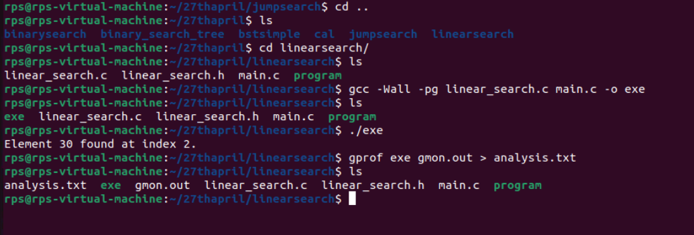
gcc -Wall -pg main.c bst.c -o exe
./exe
gprof exe gmon.out > analysis.txt
CREATING ANALYSIS REPORT FOR A PROGRAM:

Slide 3
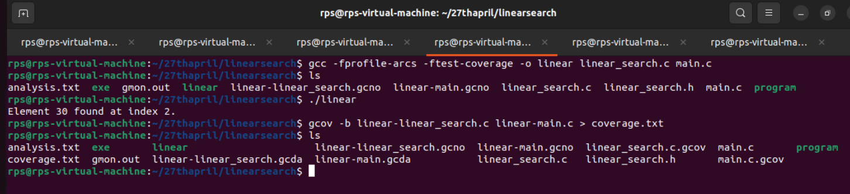
CREATING COVERAGE REPORT
gcc -fprofile-arcs -ftest-coverage -o bst bst.c main.c
./bst
gcov -b bst-main.c bst-bst.c > coverage.txt

Slide 4


